Slide 1
A Privacy-Preserving Data Valuation Visualization System
Presenter: Yap Rong Yu (U1823960A)
Supervisor: A/p Yu Han
Examiner: A/p Lin guosheng

Slide 2
Contents
Introduction
Literature Review
System Design
Demo
Q & A

Slide 3
Introduction

Slide 4
Introduction
Background
Purpose of Research
Project Scope

Slide 5
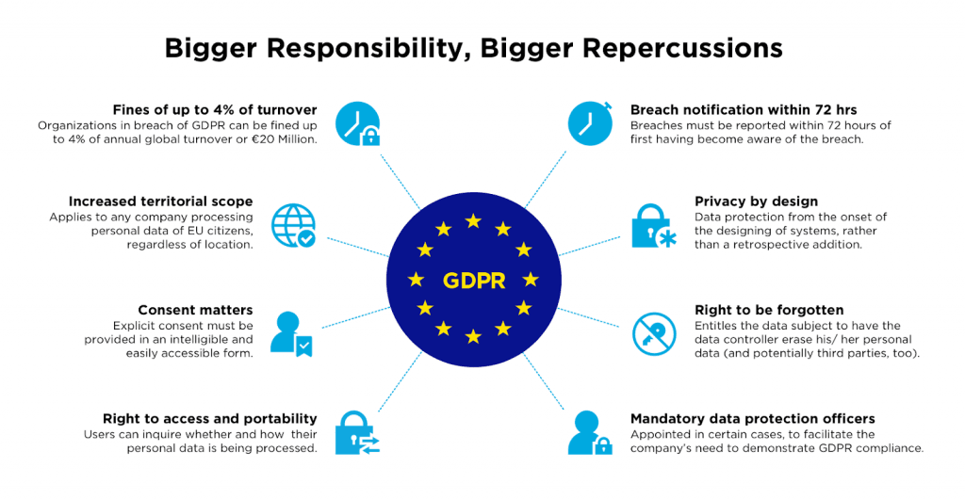
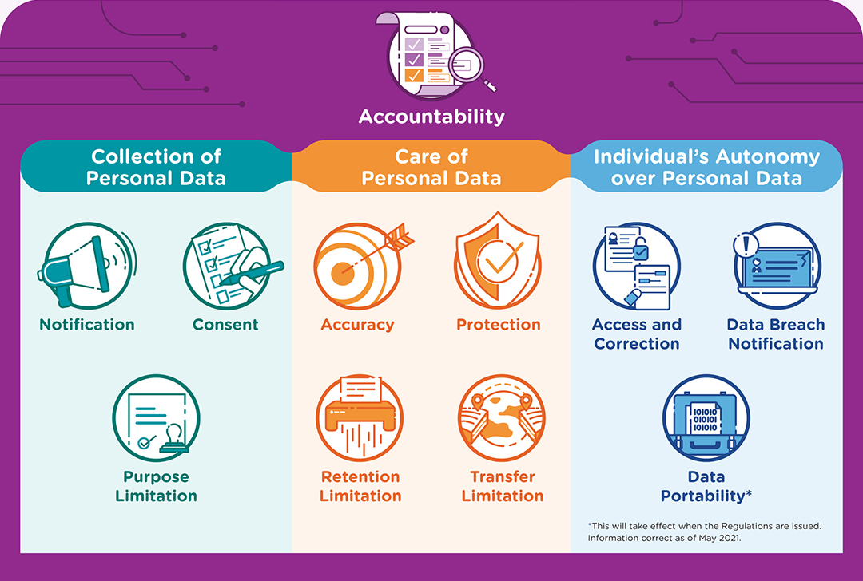
Background
Notes:
https://www.emotiv.com/glossary/gdpr/
https://www.pdpc.gov.sg/overview-of-pdpa/the-legislation/personal-data-protection-act/data-protection-obligations

Slide 6
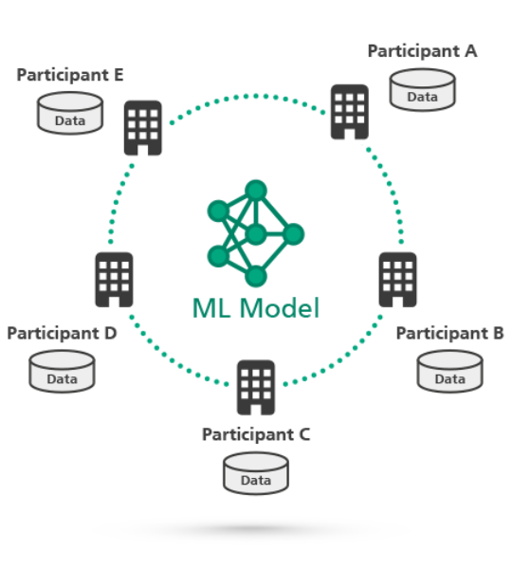
Background
Notes:
https://www.adnovum.ch/en/incubator/innovation_initiatives/collaborative_machine_learning.html

Slide 7
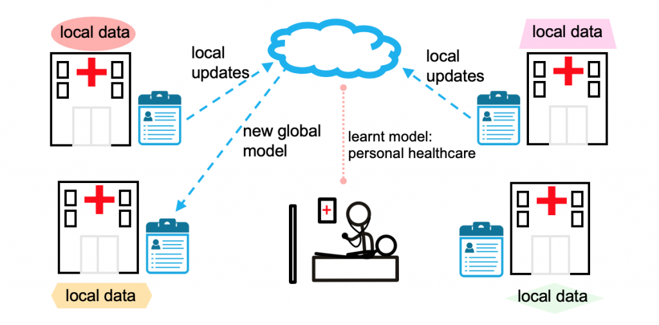
Background
Notes:
https://blog.ml.cmu.edu/2019/11/12/federated-learning-challenges-methods-and-future-directions/

Slide 8
Background
Increased regulation of data
Hard to conduct collaborative machine learning
Proposed federated learning
Lack of visualisation system for stakeholders

Slide 9
Purpose of Research
Easy to use
Easy to understand
Data Valuation
Visualisation
System
Minimum technical knowledge required

Slide 10
Purpose of research
To develop a visualisation system for stakeholders
Easy to use
Easy to understand
Minimal technical knowledge required

Slide 11
Project Scope
Develop a data valuation visualisation system
Python
Displays relevant detail to the stakeholders
Shows obvious anomaly

Slide 12
Literature Review
Shapley Value
Using Shapley Value in Federated Learning
Shapley Value Estimation
Estimation Technique
Research Gap

Slide 13
Literature Review

Slide 14
Data Valuation
Determine value of data
Examine dataset
Accuracy and completeness
Fair
Transparent

Slide 15
Shapley value
From Game Theory
Expects uneven contribution from multiple participants
Fair distribution of reward

Slide 16
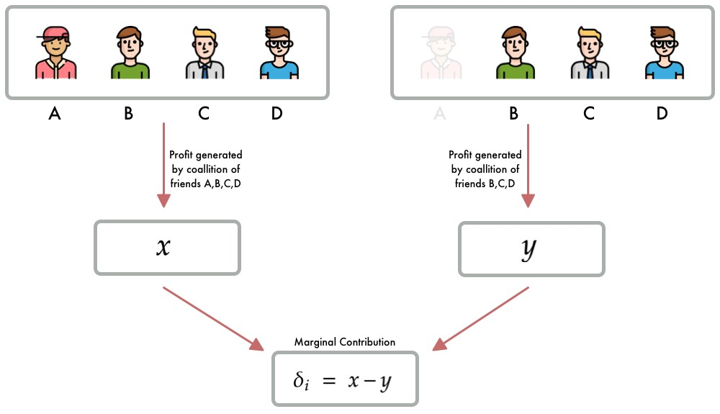
Shapley Value
Notes:
https://towardsdatascience.com/shap-shapley-additive-explanations-5a2a271ed9c3

Slide 17
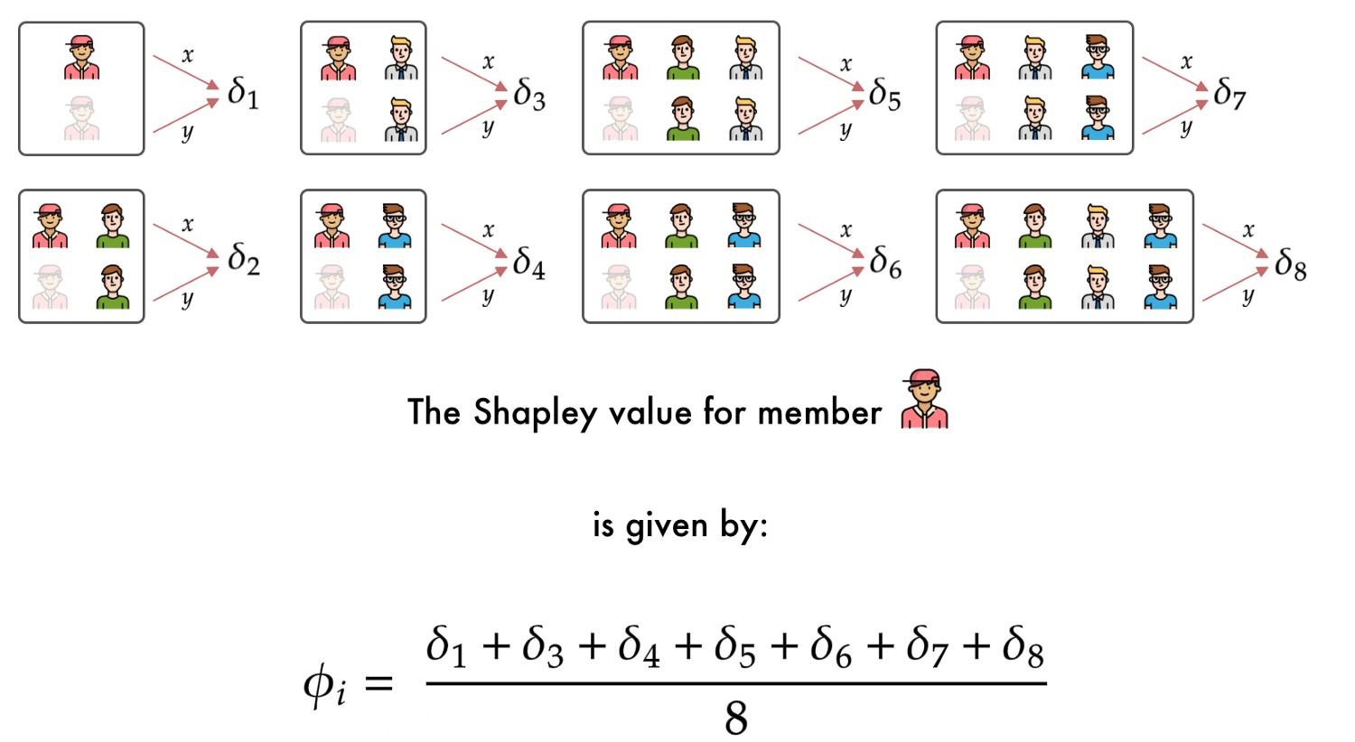
Shapley Value
Notes:
https://towardsdatascience.com/shap-shapley-additive-explanations-5a2a271ed9c3

Slide 18
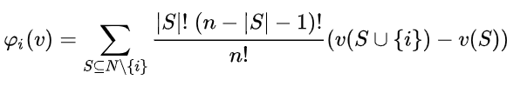
Shapley Value

Slide 19
Using Shapley Value in Federated Learning
Evaluates based on performance gain on model
No access to data set

Slide 20
Using Shapley Value in Federated Learning
Costly
Train model multiple times
Time complexity is O(2^n)
Expected 10-20 participants with huge dataset

Slide 21
Estimation of Shapley Value
Trade little accuracy loss
Reduced amount of resources required
Time complexity reduces from exponential to polynomial

Slide 22
Estimation Technique - Gradient Shapley
Train model 1 time
Record gradient
Build model for evaluation using gradients
One Round Reconstruction
Multi-Round Reconstruction

Slide 23
Estimation Technique - Truncated Monte-Carlo
Samples participant combination randomly
Reduced number training
Truncates training when marginal gain is below threshold
Set contribution to 0 and stop training
Repeated training

Slide 24
Estimation Technique - Guided Truncation Gradient Shapley (GTG – Shapley)
Records gradient
Reconstruct model for evaluation
Fixed permutation of first few positions
Between round truncation
Within round truncation

Slide 25
Visualisation system
Federated learning produces large amount of date
Able to take in the large output
Displays relevant data to stakeholders
Allows filtering of results
Display obvious anomaly

Slide 26
Research gap
Not suited to take in data from federated learning
Large number of participants
Large amount of data

Slide 27
System design

Slide 28
System Design
Application Description
User Needs
System Architecture

Slide 29
Application Description
Take in output from in state of the art Shapley valuation
GTG – Shapley
Displays relevant data to the stakeholders
Allow users to choose and filter

Slide 30
User interaction
Participants
Initiators
Owners
Train
Model
Invites
Manage
Model

Slide 31
User needs - federation owners
View all models
Manage participant reputation
Manage participant recommendation list

Slide 32
User needs - Federated Learning Initiators
View participant reputation
Invite participants for federated learning
Monitor federated learning process
View participant contribution
View model details

Slide 33
User needs - Participants
View contribution and model performance
Compare contribution with other participants

Slide 34
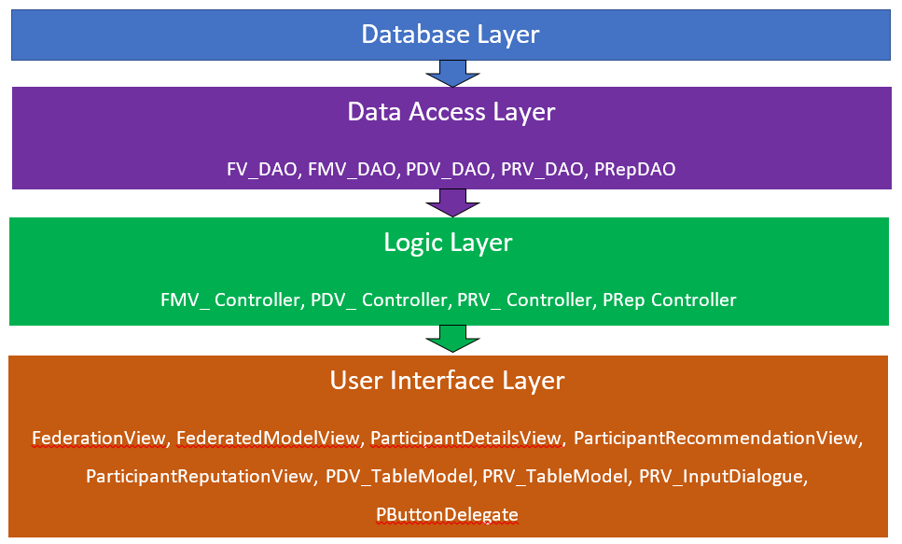
System Architecture

Slide 35
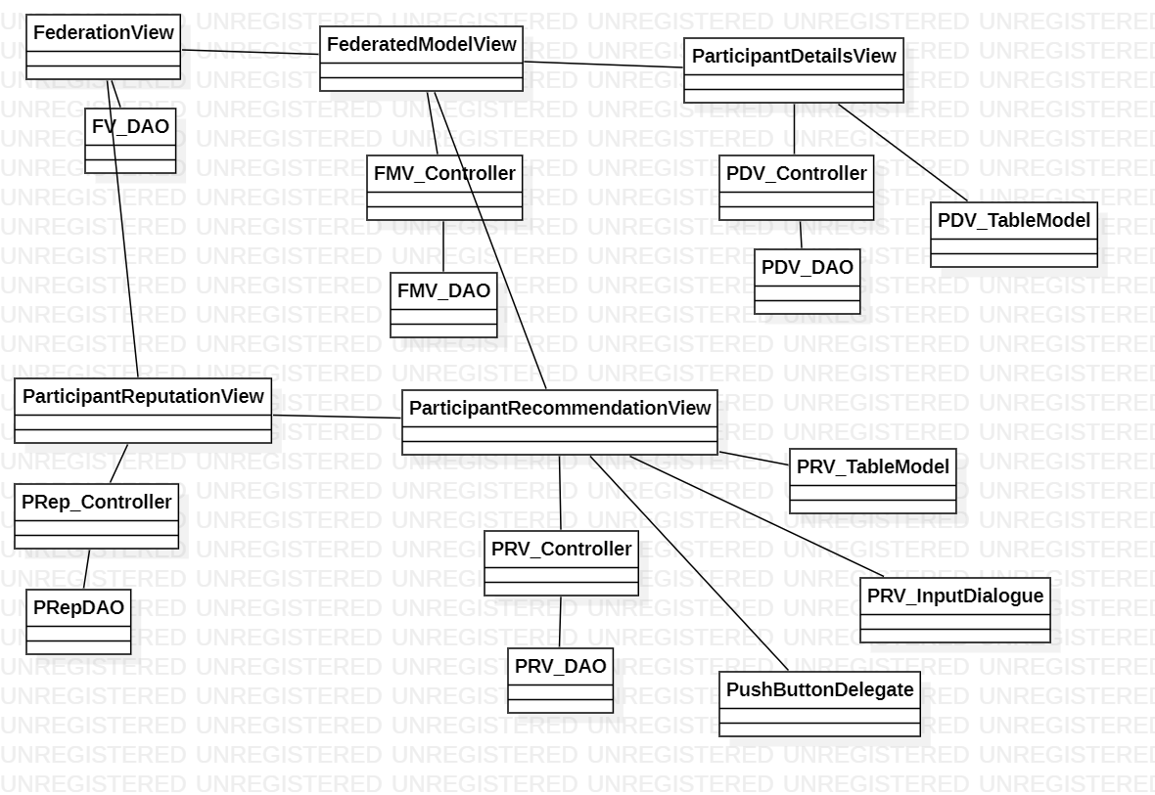
System Architecture

Slide 36
System Architecture
Layered Architecture
Database Layer
Data Access Layer
Logic Layer
User Interface Layer

Slide 37
System Architecture - Database Layer Database
Database
Represented by a pickle file

Slide 38
System Architecture – Data Access Layer
Data Access Object (DAO)
Retrieves data from database
Pass data to Logic layer
Prevents unauthorised access to database

Slide 39
System Architecture - Logic Layer
Controllers
Data processing
Pass data to User Interface Layer

Slide 40
System Architecture - User Interface Layer
Views and UI classes
Displays data
Respond to user interactions

Slide 41
Demo

Slide 42
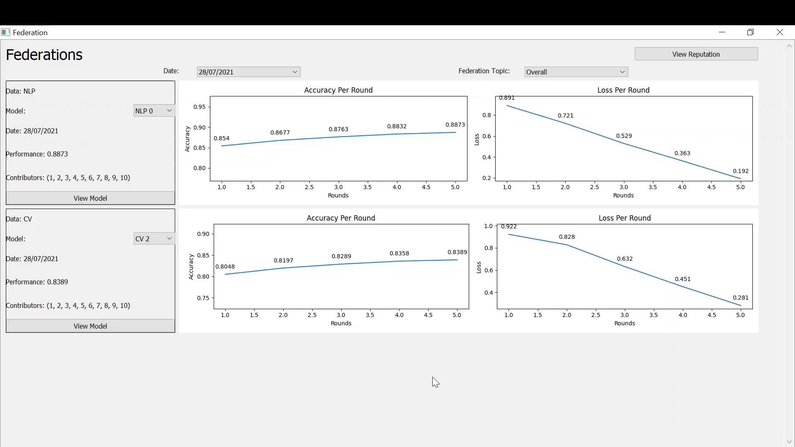

Slide 43
Q & A

Slide 44
Thank You

